Slide 1
Russia. Recent Developments and Long-Term Challenges
IMF Office in the Russian Federation
October 2018
Notes:
For latest IMF-related analysis and news see https://www.imf.org/external/country/rus/ and https://www.imf.org/external/country/rus/rr/

Slide 2
Recent Developments & Short-Term Outlook
High Global Growth and Policy Normalization in Advanced Economies.
Sustained Geopolitical and Inward Trade Policy Tensions. Higher Oil Prices.
2017: A Solid Macro
Growth resumed amid low Inflation.
Prudent Fiscal Policy and increasing buffers.
Monetary Policy normalization continued.
2018: Cyclical Recovery to Complete
Moderate growth to continue, output gap to close.
Inflation to remain at or below target.
Notes:
For latest IMF-related analysis and news see https://www.imf.org/external/country/rus/ and https://www.imf.org/external/country/rus/rr/

Slide 3
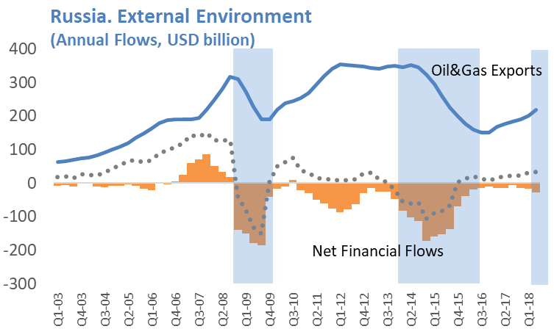
Higher Oil Prices but Geopolitical Tensions
Higher oil prices and the floating exchange rate helped as geopolitical tensions increased, but risks remain.
CBR’s Reserves
Notes:
Source: IMF staff calculations on the basis of official data

Slide 4
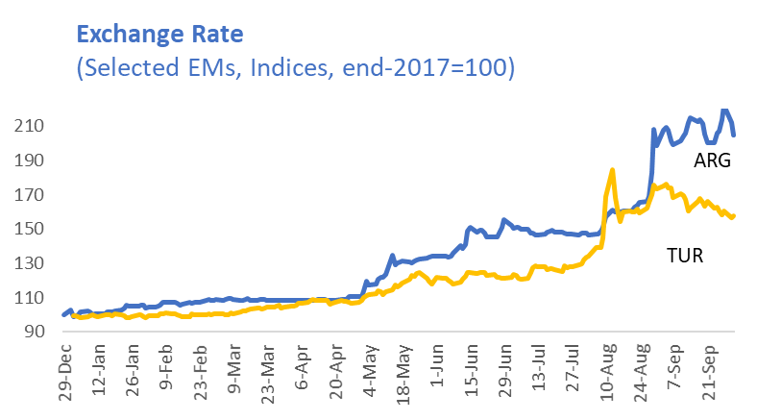
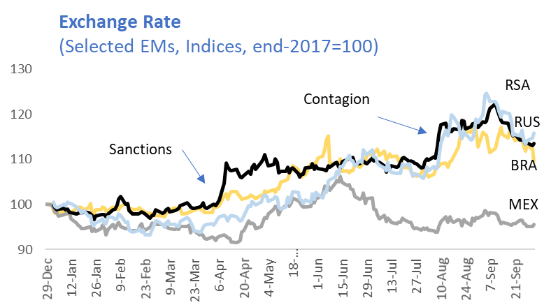
Some Contagion from Emerging Markets
External financial flows to Russia are reacting to both sanctions and to ongoing adjustment in a number of EMs
Notes:
Source: IMF staff calculations on the basis of official data

Slide 5
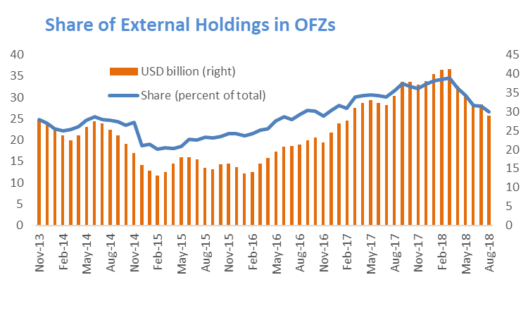
Some Contagion from Emerging Markets
OFZ Yield curve moved up and foreign holdings in the OFZ market decreased significantly
Sanctions
Notes:
Source: IMF staff calculations on the basis of official data

Slide 6
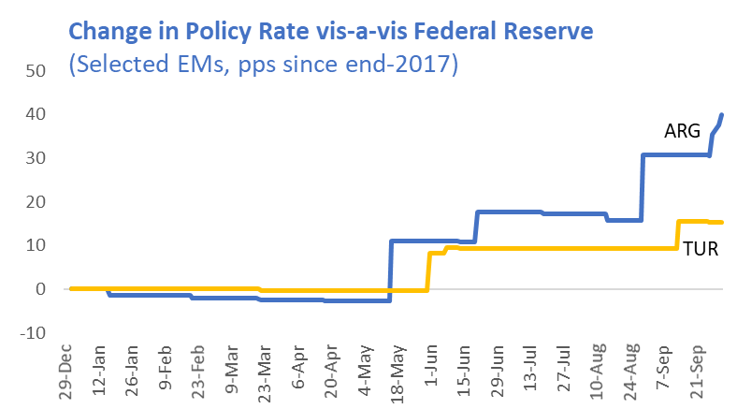
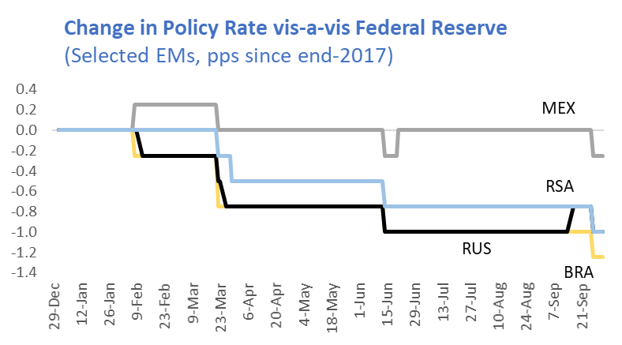
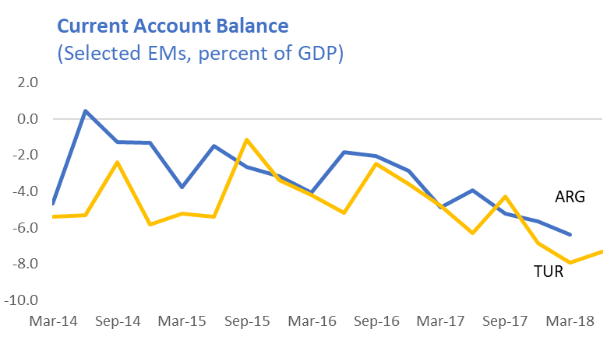
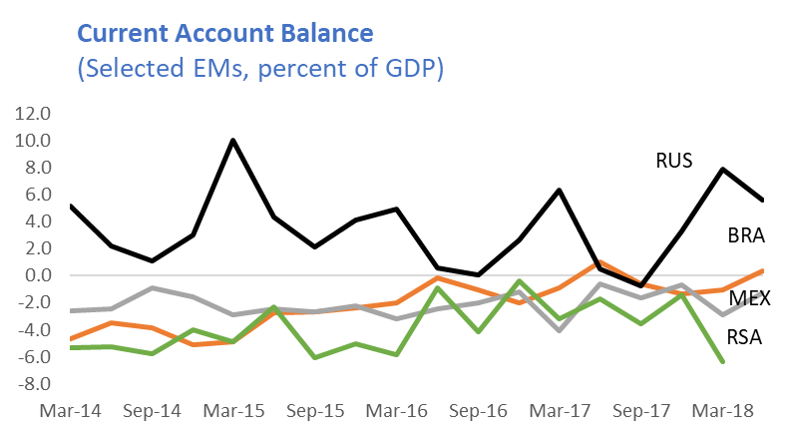
Some Contagion from Emerging Markets
Not all Emerging Markets are alike, the policy cycle and current account positions differ markedly across EMs
Notes:
Source: IMF staff calculations on the basis of official data

Slide 7
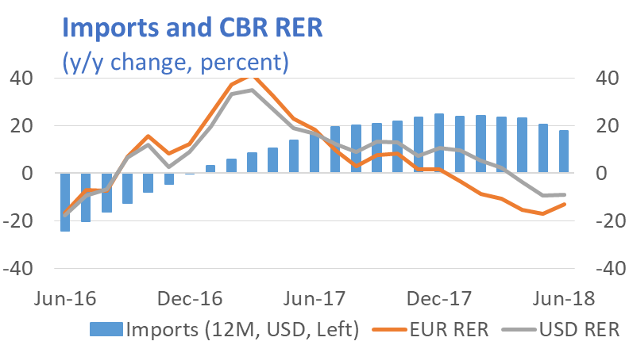
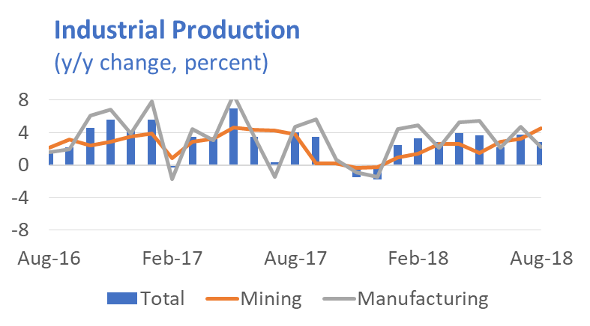
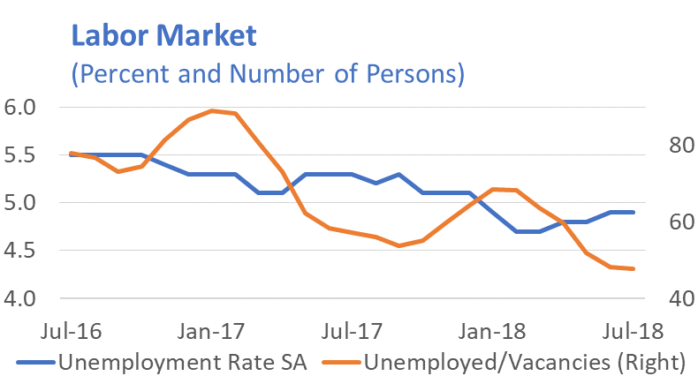
Cyclical Recovery to Complete in 2018
Despite some weakness at end-2017, high frequency indicators show moderate demand & supply expansion, supported by stable employment
Notes:
Source: IMF staff calculations on the basis of official data

Slide 8
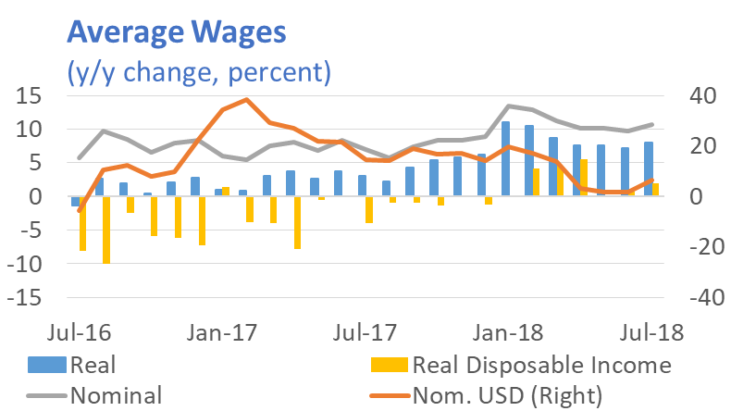
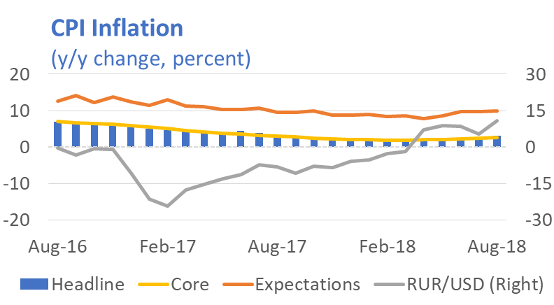

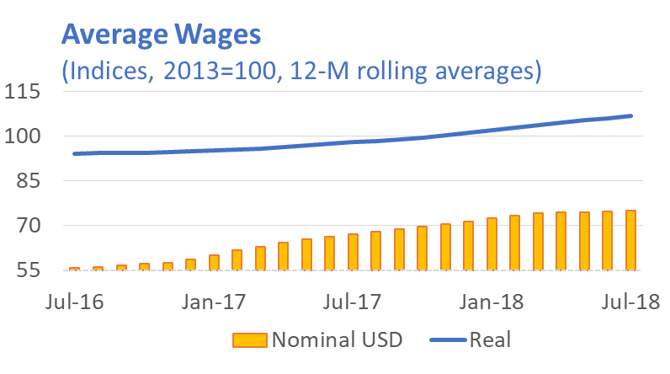
Cyclical Recovery to Complete in 2018
Real wages are growing, and real disposable income is stabilizing, amid decreases in inflation
Notes:
Source: IMF staff calculations on the basis of official data

Slide 9
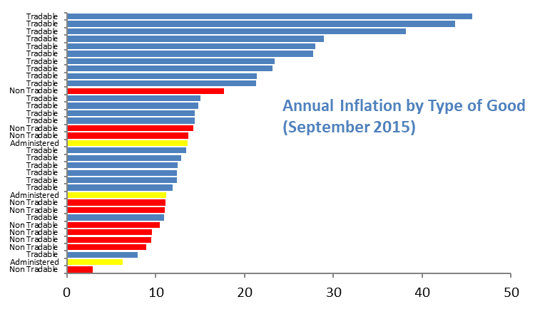
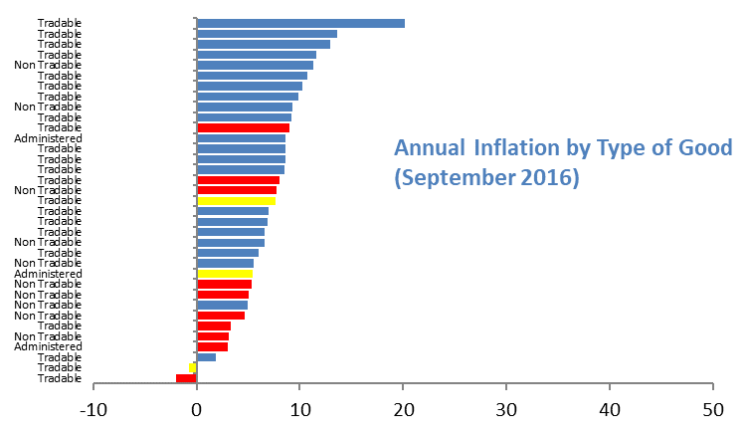
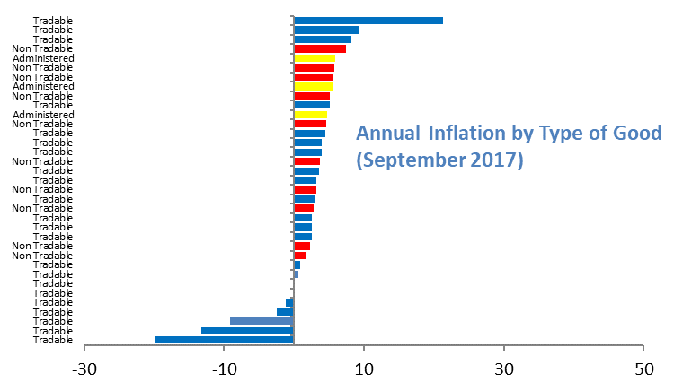
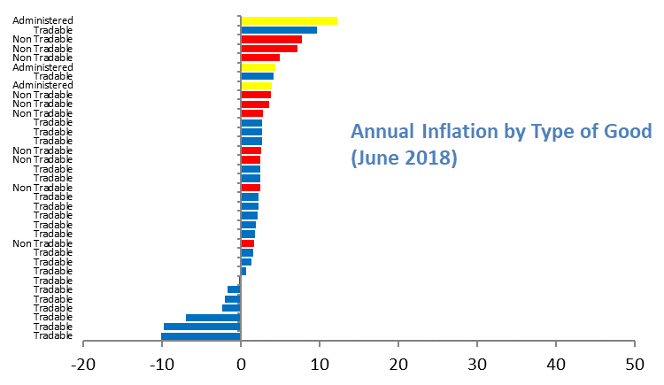
Cyclical Recovery to Complete in 2018
Relative Prices are stabilizing at more competitive levels than before the dual shocks at end-2014
Notes:
Source: IMF staff calculations on the basis of official data

Slide 10
Policies for 2019-24 to Unveil in 2018
Objectives include accelerating growth, reducing poverty, strengthening public infrastructure, improving sustainability of fiscal policy among other…
What We Know…
Infrastructure Fund of RUR3.5 Trillion through 2024
VAT increase to 20 percent from 2019
Tax “Maneuver” for the Oil Sector
Pension Reform to increase retirement age
Increase/Refocus federal spending
…Further Details with Budget for 2019-21
Full evaluation possible when further details are unveiled in Q3.
Notes:
For latest IMF-related analysis and news see https://www.imf.org/external/country/rus/ and https://www.imf.org/external/country/rus/rr/

Slide 11
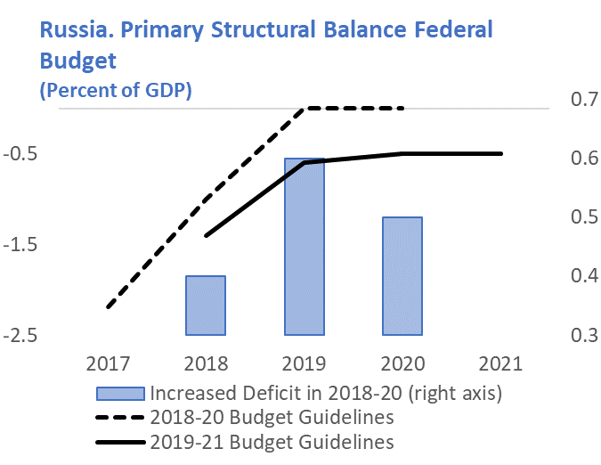
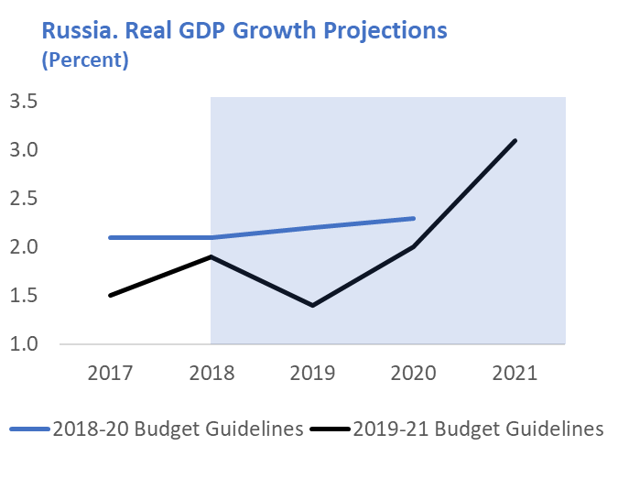
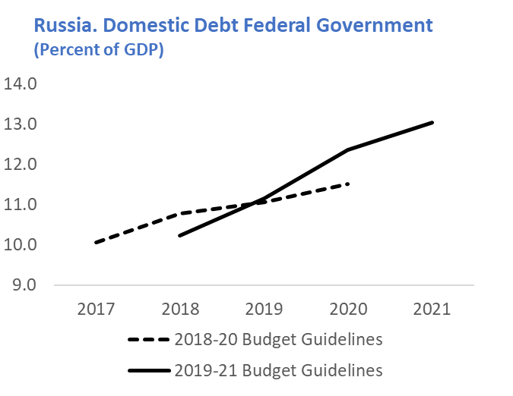
Policies for 2019-24 to Unveil in 2018
…new budgetary guidelines envisage a temporary relaxation of primary balance target, increased domestic debt financing and a pick-up in GDP growth
Notes:
Source: IMF staff calculations on the basis of official data

Slide 12
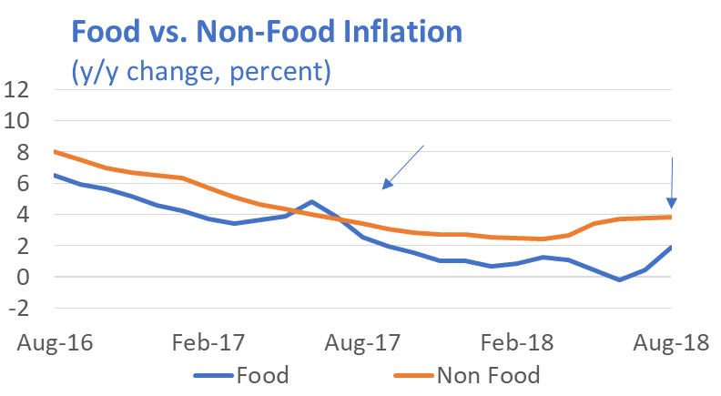
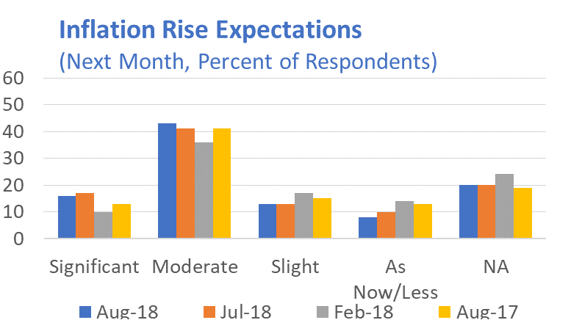
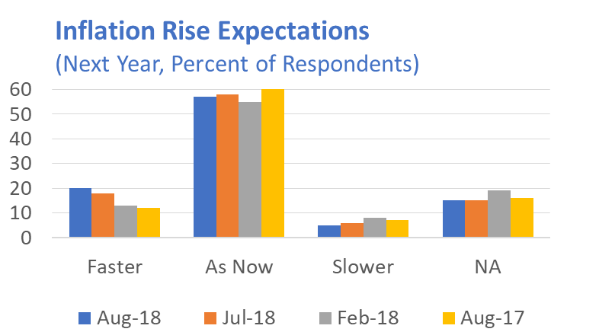
Macro Policies in 2019-21: A Balancing Act
Looser fiscal policy in 2019-21 will likely provide a reflationary push. Monetary policy needs to remain vigilant that expectations remain anchored at 4 percent.
Notes:
Source: IMF staff calculations on the basis of official data

Slide 13
Risks, Vulnerabilities, and Resiliency
Policy normalization in AEs – Financial Flows to Emerging Markets more volatile
Global growth high but downside risks prevail in the medium term.
Escalation of Geopolitical Tensions
On Domestic Front: Oil Price weakening reform resolve
Russia better prepared: Twin current and fiscal surpluses, low public debt, floating exchange rate, adequate external buffers, Positive Net External Position.
Notes:
For latest IMF-related analysis and news see https://www.imf.org/external/country/rus/ and https://www.imf.org/external/country/rus/rr/

Slide 14
Long-Term Challenges

Slide 15
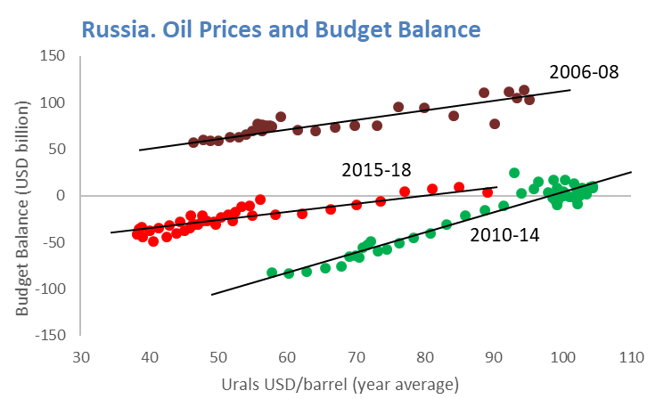
Need for a Continuation of Strong Macro Policies
Fiscal Rule, Inflation Targeting and a Floating Ruble are working. Need to strengthen these policies, avoid tampering.
Notes:
Source: IMF staff calculations on the basis of official data

Slide 16
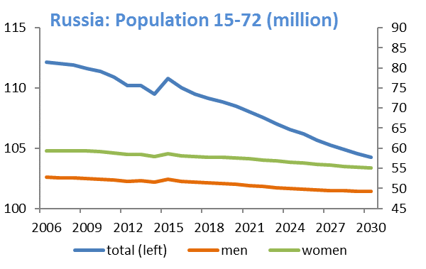
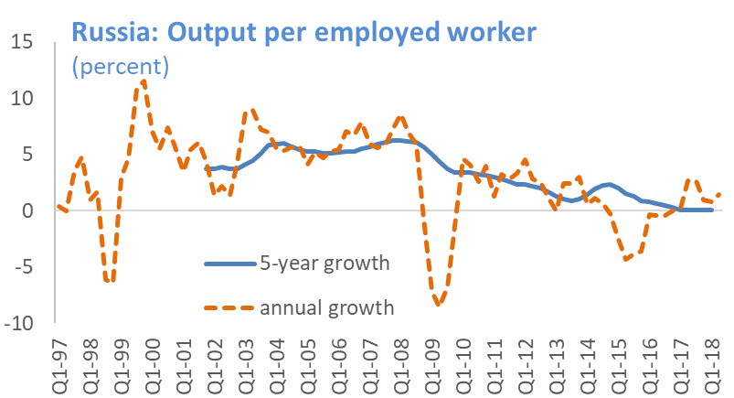
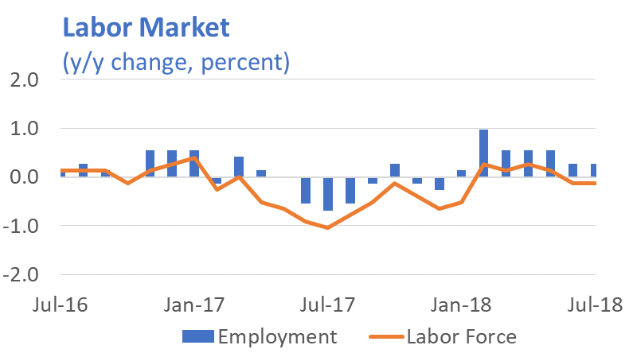
L-T Growth, Productivity and Demographics
Growth in output per worker has steadily decreased, and working age population to decrease too in the next few years
Notes:
Source: IMF staff calculations on the basis of official data

Slide 17
The State’s Footprint…
Notes:
Source: IMF staff calculations on the basis of official data

Slide 18
The State’s Footprint…
Notes:
Source: IMF staff calculations on the basis of official data

Slide 19
Market Concentration
Notes:
Source: IMF staff calculations on the basis of official data

Slide 20
In the L-T, Growth to Remain Moderate…
…Unless Reforms, to Address:
Domestic market growth limited by demographics
A deep state ‘footprint’
Concentration and unequal income distribution
Infrastructure bottlenecks and regional disparities
Relatively low (and concentrated) investment
Still-low international trade integration
Keeping Good Macro Policies a Precondition

Slide 21
Большое Спасибо
Notes:
For latest IMF-related analysis and news see https://www.imf.org/external/country/rus/ and https://www.imf.org/external/country/rus/rr/

