Slide 1
ECONOMIC CHALLENGES FOR A POST-PANDEMIC EUROPE
HIGHLIGHTS FROM THE IMF'S 2021 CONSULTATION ON COMMON EURO AREA POLICIES
ALFRED KAMMER DIRECTOR OF THE EUROPEAN DEPARTMENT, IMF

Slide 2
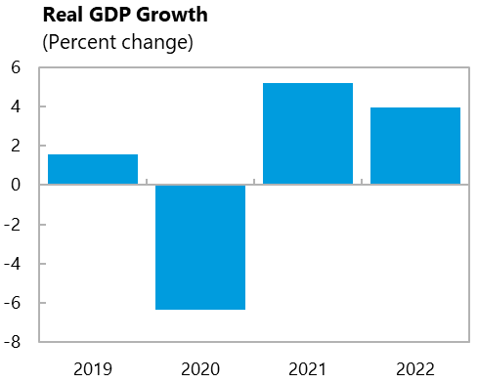
A rapid recovery, thanks to forceful policies that have:
Supported disposable incomes
Maintained worker-firm links
Prevented mass bankruptcies
Kept credit flowing
Source: IMF WEO.

Slide 3
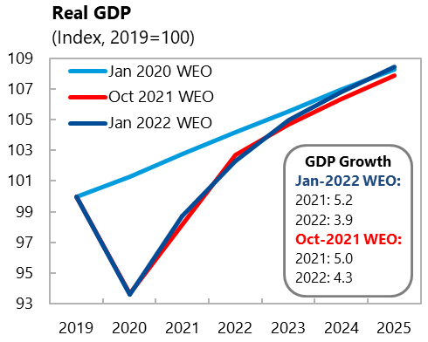
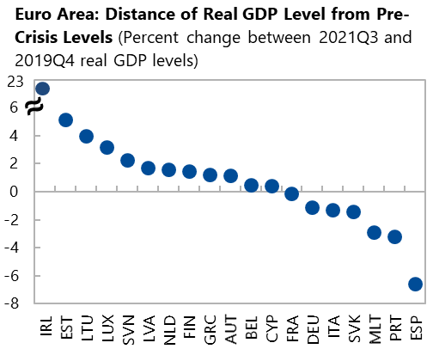
Yet the recovery is uneven
Sources: IMF WEO; and IMF staff calculations.
Sources: IMF WEO; and IMF staff calculations.

Slide 4
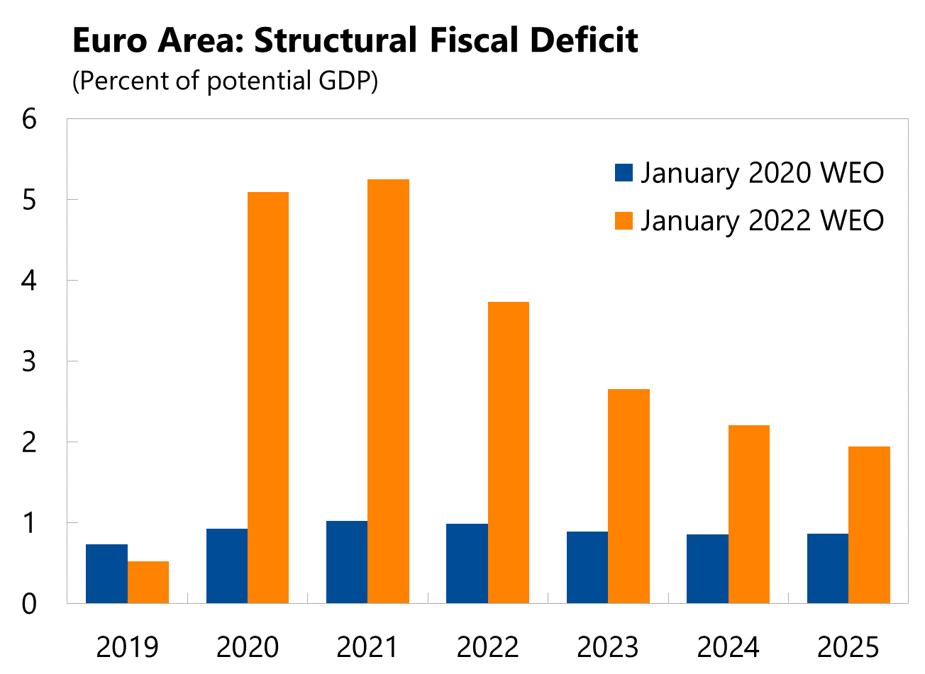
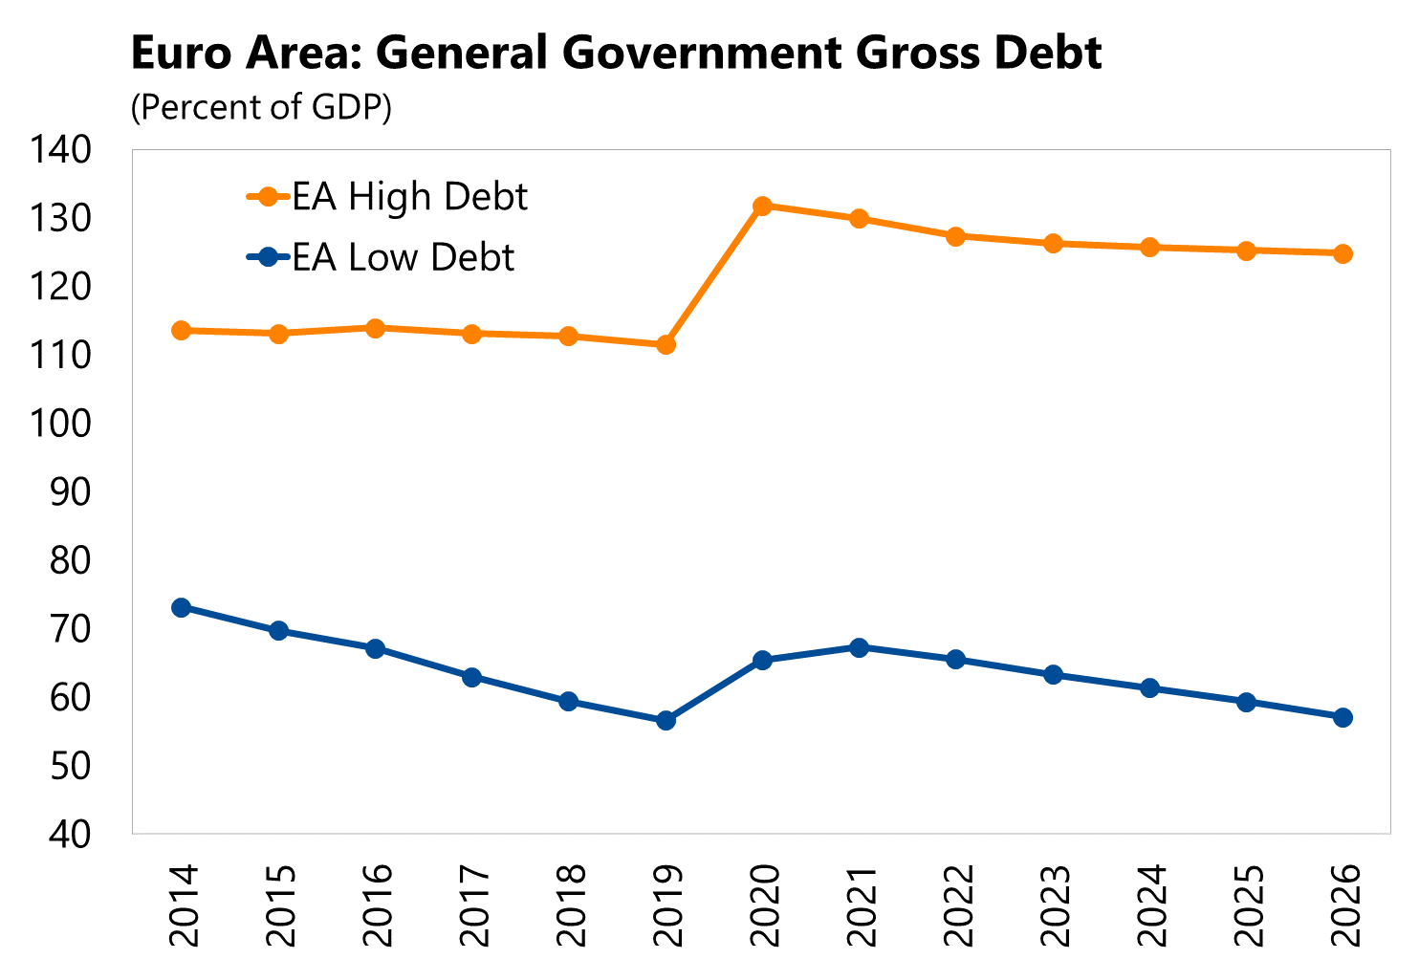
Fiscal policy supportive and increasingly targeted
Sources: IMF, World Economic Outlook; and IMF Staff calculations.
Sources: IMF, World Economic Outlook; and IMF staff calculations.

Slide 5
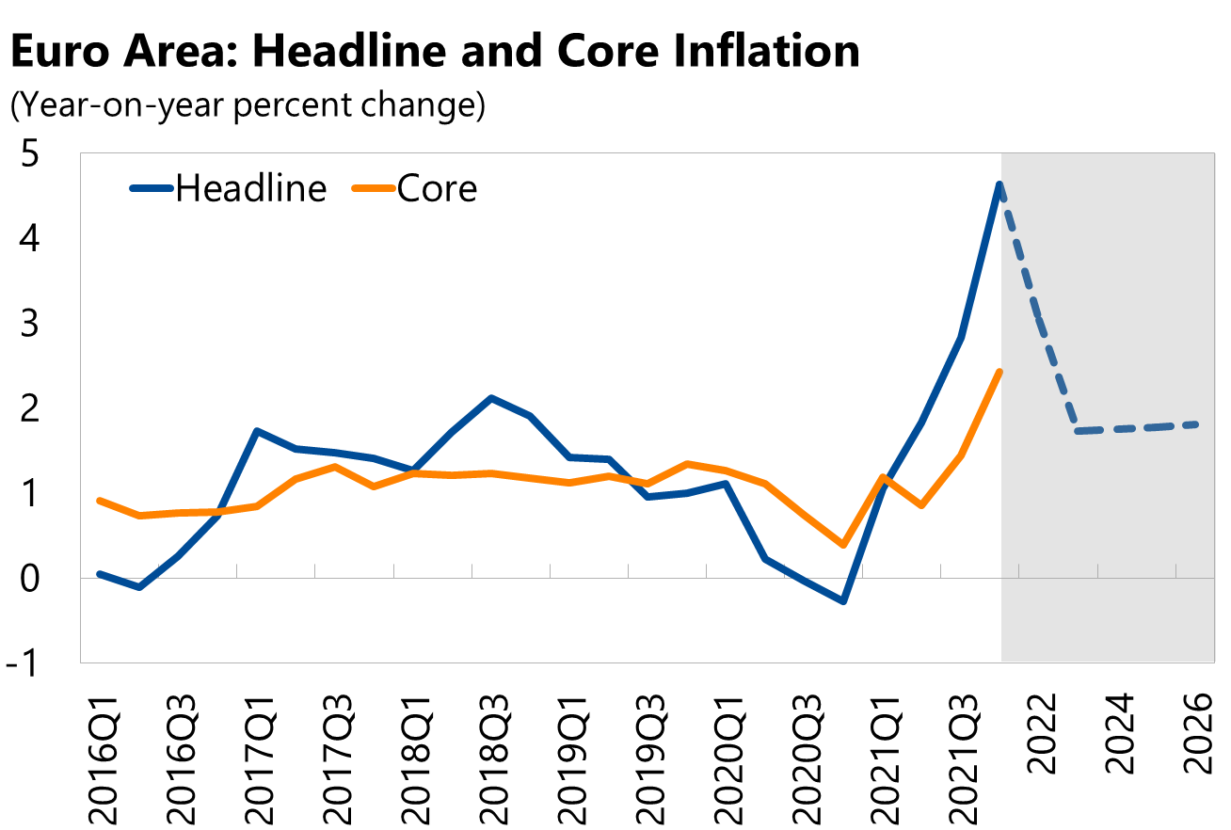
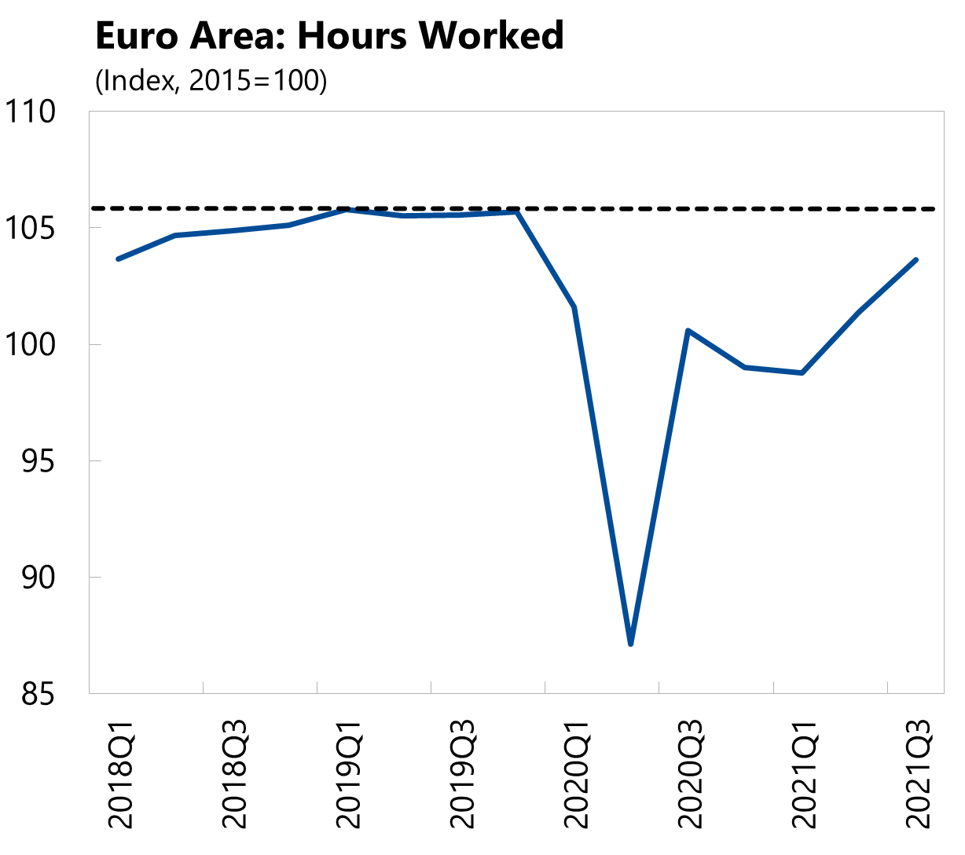
ECB should continue supporting the recovery, inflation risks tilted to the upside
Sources: Eurostat; Haver Analytics; and IMF, World Economic Outlook.
Sources: ECB; Haver Analytics; and IMF staff calculations.

Slide 6
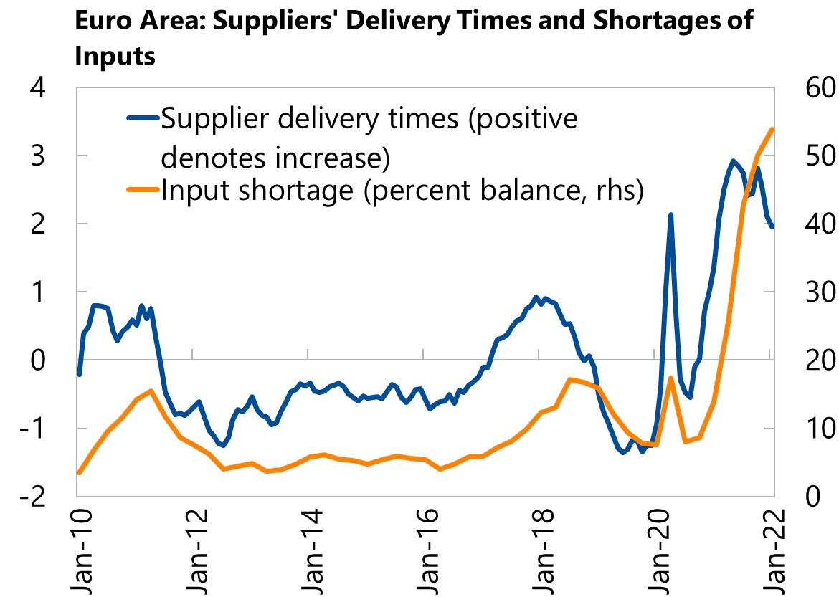
Energy prices and supply bottlenecks: An upside risk to inflation, a downside risk to activity
Sources: Bloomberg Financial L.P.; and Intercontinental Exchange.
Sources: EC; and IHS Markit.

Slide 7
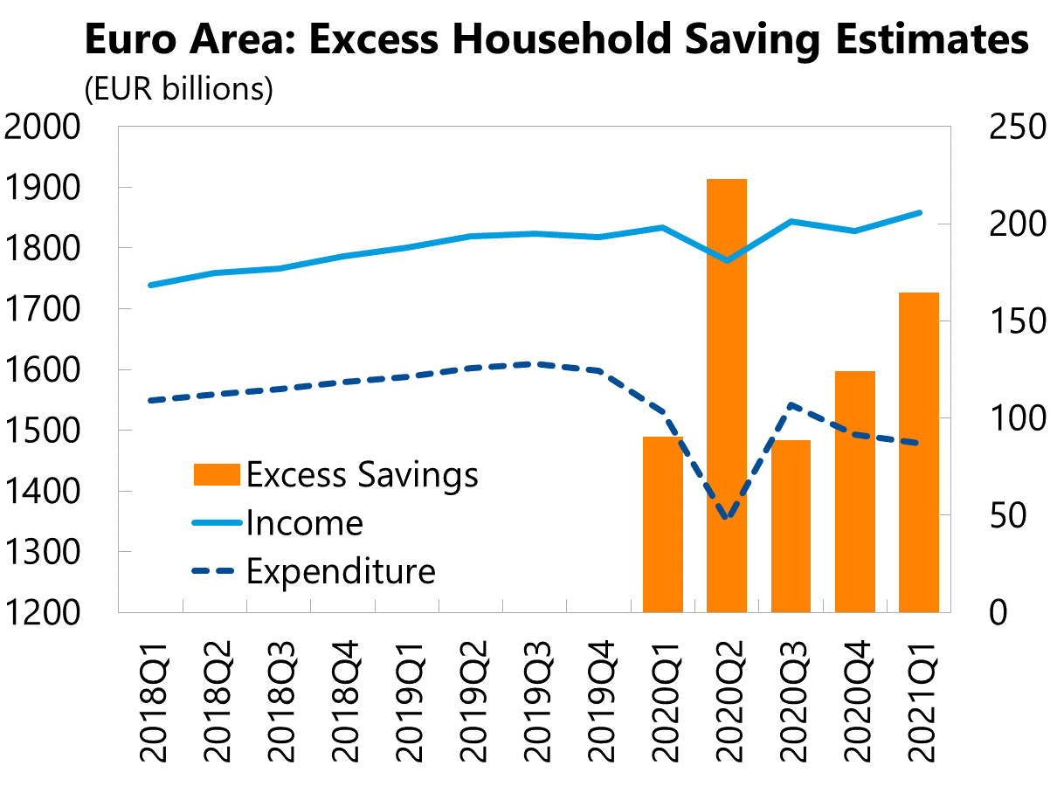
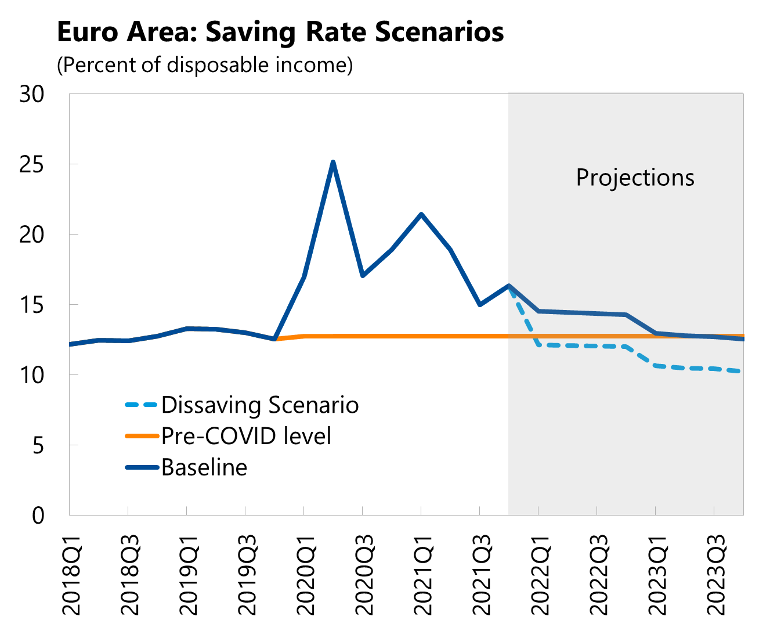
Excess household savings: An upside risk to inflation and activity
Sources: Eurostat; and IMF Staff calculations.
Sources: Eurostat; ECB; Haver Analytics; and IMF Staff calculations.

Slide 8
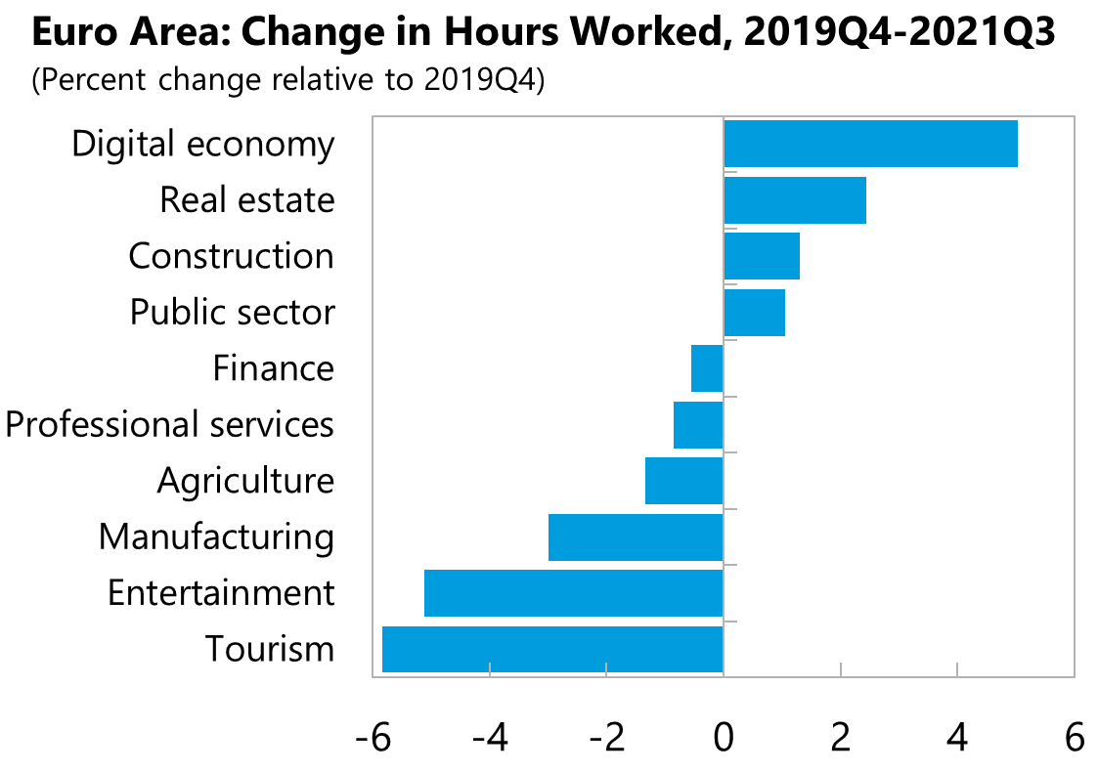
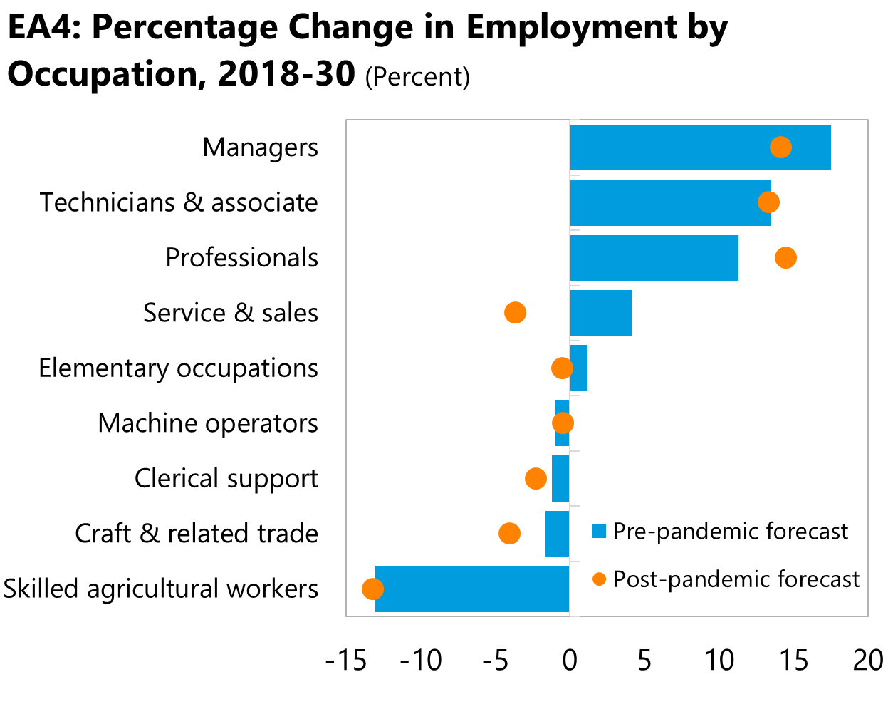
Large labor reallocation needs call for bold policies and protection of vulnerable groups
Sources: Eurostat; and IMF staff calculations.
Sources: Eurostat; Ice and Others (2021); European Centre for the Development of Vocational Training (CEDEFOP, 2020); and IMF staff calculations. EA4: Simple average of Germany, Spain, France, and Italy. Baseline long-term employment is based on CEDEFOP (2020) Skills Forecast data. EA4 = Germany, Spain, France, and Italy.

Slide 9
Stronger EU and global architecture
Reform EU fiscal rules
Current rules complex
Balance debt control and stabilization
Support global economic governance
Trade tensions and investment distortions
Global corporate income tax
Complete the financial single market
EC's Banking Package minimize the divergence with global standards
Banking Union
Capital Markets Union
Support global pandemic recovery
Vaccine and antivirals: production and export

Slide 10
NGEU an important step towards "Fit for 55", but more is needed to meet climate goals
Public Policy
NGEU
EU Green Investment Fund
Carbon Pricing
ESG
Public Investment
Private Investment
Green investment needs

